Slide 1







TIMETABLE PLANNER WEBSITE
AC4150E
-
152296
Me-fi Prototype
From:
Group 3

Slide 2
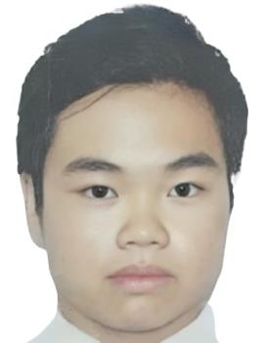





Nguyen Gia Bao
Nguyen Do Hoang Minh
Nguyen Huu Phong
20210099
ET-E16 – K66
20210591
ET-E16 – K66
20210668
ET-E16 – K66

Slide 3






Table of Contents!
Revised Interface Sketches
Introduction
Me-fi Task Flows
Tasks
Prototype Implementation
Also included: Appendix
Usability Goals & Key Measurements

Slide 4

01
Introduction

Slide 5





Problem
Solution
HUST students face difficulties visualizing their timetables before course registration due to the lack of an official tool.
A user-friendly app that allows students to customize and visualize their timetables quickly, ensuring smooth course registration.
User Focus
HUST students.

Slide 6


Value Proposition
Effortless timetable planning tailored for HUST students.

Slide 7
Encoded Values
Intuitiveness
Personalization
Efficiency
Spatial Awareness
Students should quickly
understand how to use the
website without needing instructions.
Different students have
different scheduling needs,
so flexibility is crucial.
Students need to organize
timetables quickly to save
time during course
registration.
Knowing where classes are
located helps students plan
their day effectively.

Slide 8
Value-Aligned Features
Intuitiveness
Personalization
Efficiency
Spatial Awareness
Drag-and-drop Excel upload
with instant confirmation.
Set custom preferences like
off-days or study times.
Auto-generate timetable based
on user preferences.
Campus map showing class
locations clearly.

Slide 9
02
Tasks

Slide 10



3 Tasks
Simple Task
Moderate Task
Complex Task
Export the personalized
timetable to a PDF
View the campus map
with class locations
Automatically generate and
view a personalized
timetable

Slide 11
03
Usability Goals & Key Measurements

Slide 12

Usability Goals and Key Measurements
1) Efficiency
Rationale: The website should help students complete tasks quickly to streamline course registration.
Measurement: Number of clicks needed to complete core tasks like generating or exporting a timetable.
2) Ease of Use
Rationale: Students should quickly understand and use the website without frustration.
Measurement: Time taken (in seconds) to upload an Excel file and generate a timetable.

Slide 13
Progress Towards Usability Goals
1) Efficiency
Reorganize sections to help users work more efficiently.
Break tasks into separate pages, completing each task within its respective page.
In Development: An "Album" feature to save and recall previous timetables (optional).
2) Ease of Use
Redesign button placements for better visibility and readability.
Use clear, obvious labels for sections and buttons to ensure instant understanding.

Slide 14

04
Revised Interface Sketches

Slide 15

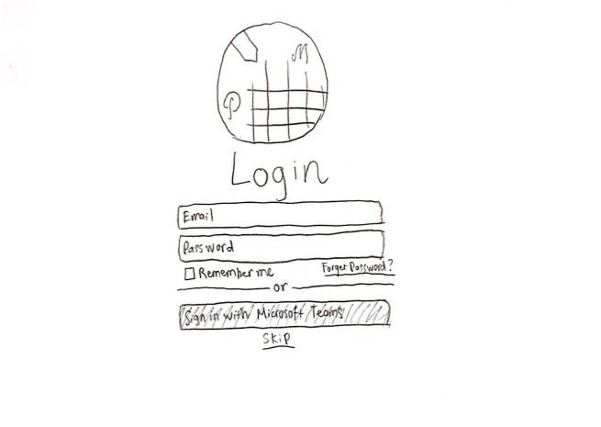
Change 1: Login Page
Before

Slide 16
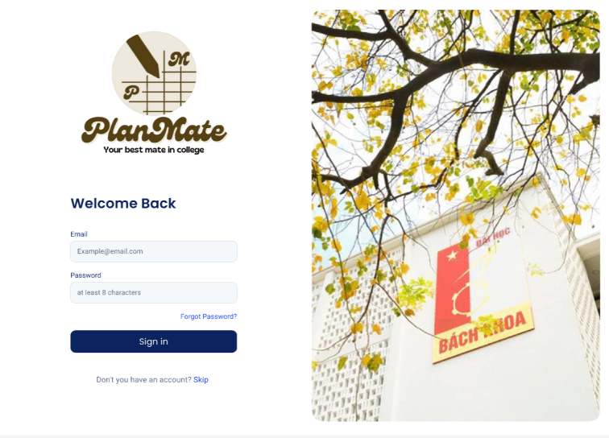
Change 1: Login Page
Move to the left
New!
After

Slide 17
Change 1: Login Page
Changes
Move the login box to the left
To create a more balanced layout and ensure better visual flow, improving user experience.
Add an image of HUST campus to the right
Increases brand recognition and creates a more familiar and engaging environment for users.

Slide 18
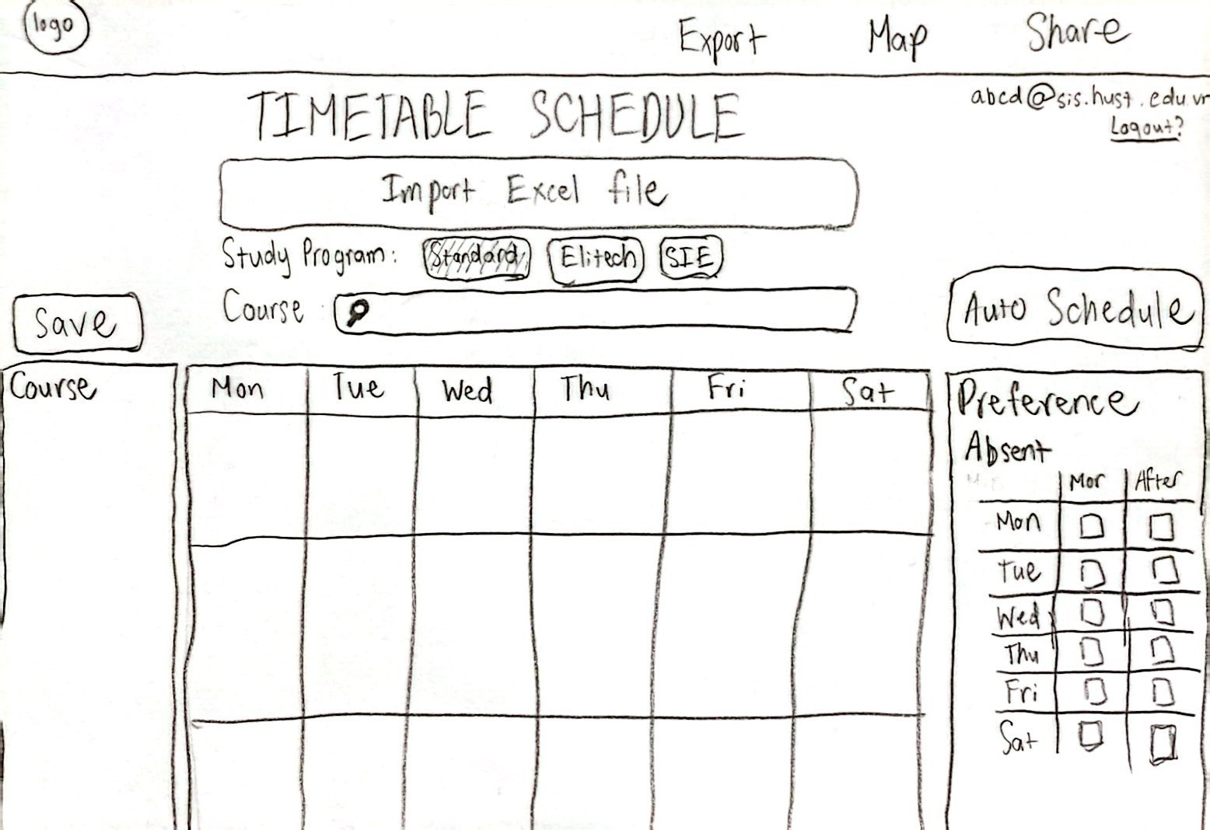
Change 2: Timetable/Schedule Page
Before

Slide 19
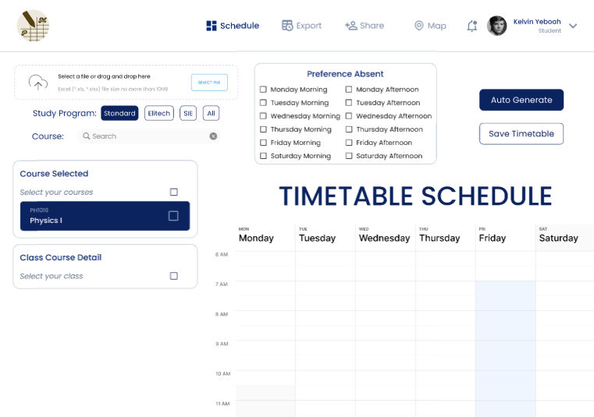
Change 2: Timetable/Schedule Page
New
New
Move to the left
Rearrange buttons
Move to the right
After

Slide 20
Change 2: Timetable/Schedule Page
Changes
Add a "Schedule" page button (instead of using the logo)
Provides clearer navigation and makes it easier to return to the schedule.
Move the "Upload File" and "Search Course" sections to the left
Creates a more organized layout and improves accessibility.
Move the "Preferences" section to the left and adjust checkbox options
Improves readability by separating options, making it more user-friendly.
Reorganize the "Auto Generate" and "Save" buttons close together
Enhances efficiency by grouping key actions for quicker completion.
Shift the timetable slightly to the right
Creates a balanced, natural visual flow after layout adjustments.
Add a button/tab for the profile instead of email/logout in the corner
Improves accessibility to profile and logout options, enhancing navigation.

Slide 21
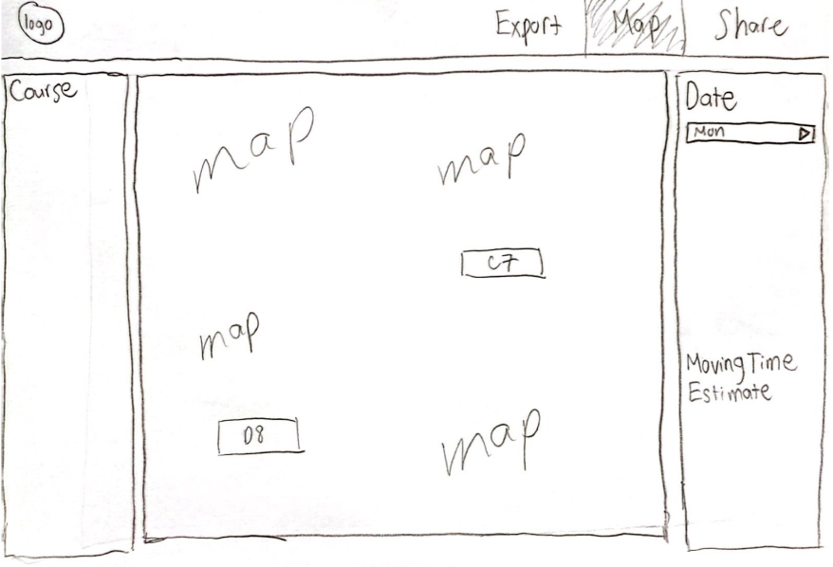
Change 3: Map Page
Before

Slide 22
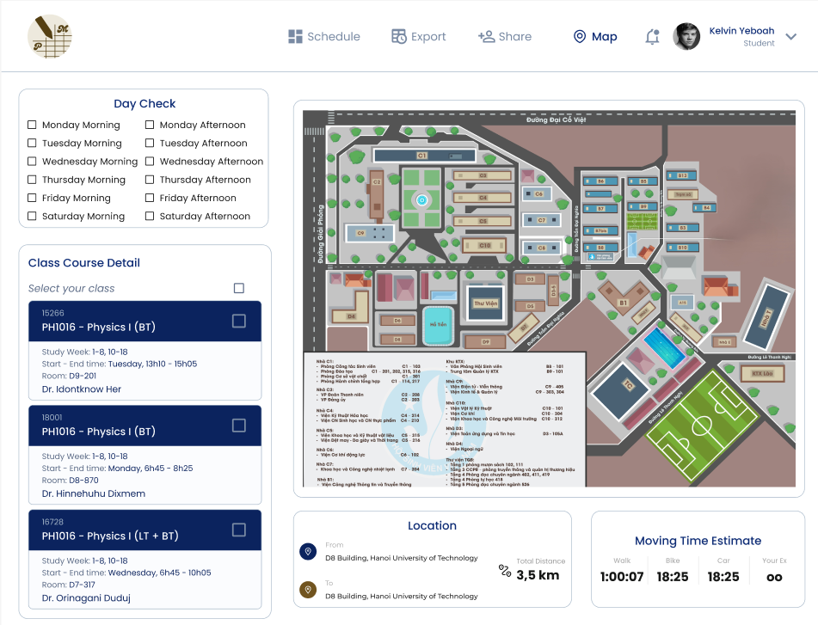
Change 3: Map Page
Move to the left Change into checkboxes
Move to the right
Separate from the “Day Check” box
Move down here
After

Slide 23
Change 3: Map Page
Changes
Move "Day Check" to the left and replace the dropdown with checkboxes
Synchronizes with the course schedule selection, making it more intuitive and consistent.
Separate "Moving Time Estimate" from "Day Check" and move it to the bottom, adding extra details
Improves clarity by isolating time estimates and providing additional information for better planning.
Shift the map to the right
Creates a more balanced layout after rearranging the elements.

Slide 24
05
Me-fi Task Flows

Slide 25
3 Task Flows
Simple Task
Moderate Task
Complex Task
Export the personalized
timetable to a PDF
View the campus map
with class locations
Automatically generate and
view a personalized
timetable

Slide 26
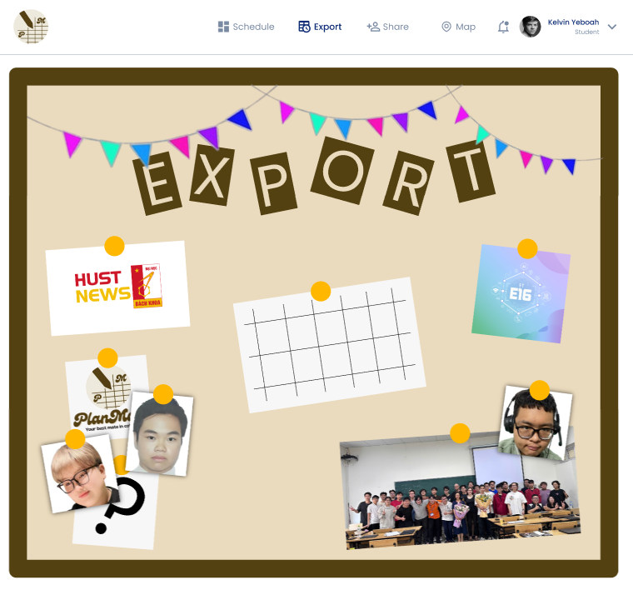
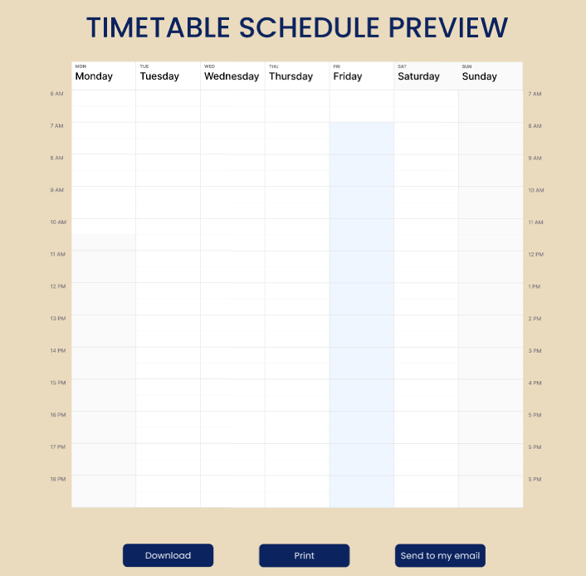
Simple Task Flow
Export the personalized
timetable to a PDF
[Click “Export” tab]
[Click the picture of the timetable]
[Click “Download” button]

Slide 27
Moderate Task Flow (1)
View the campus map
with class locations
[Click “Map” tab]

Slide 28
Moderate Task Flow (2)
View the campus map
with class locations
[Choose wanted days in “Day Check” checkboxes]
[Choose wanted courses to see the classes]
[The map displays the classes and estimate moving time shows up]

Slide 29
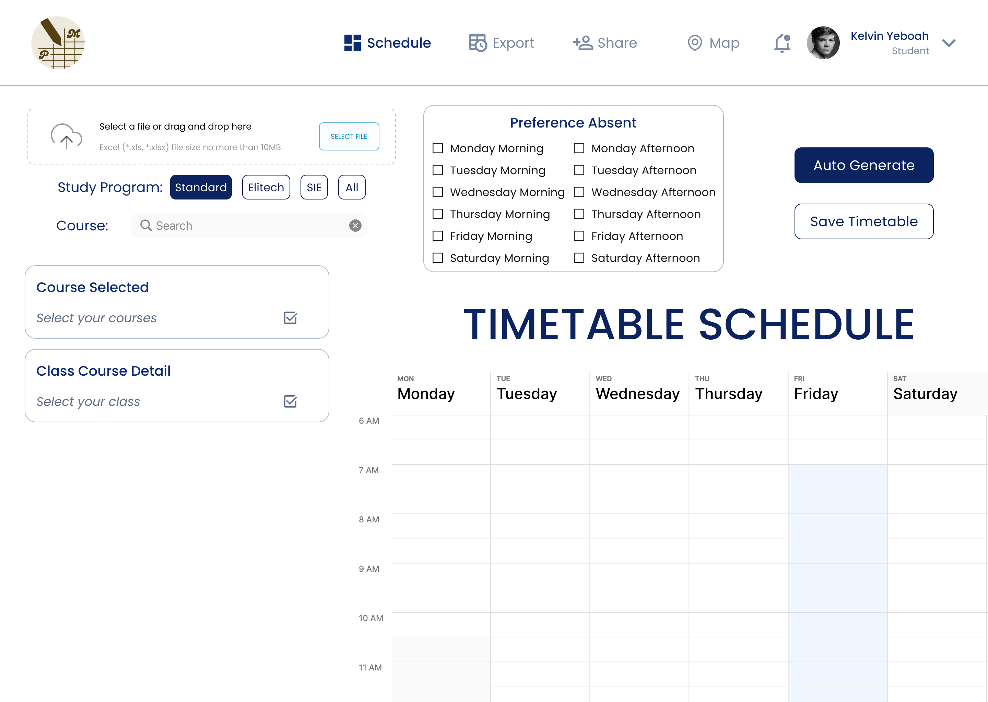
Complex Task Flow (1)
Automatically generate and
view a personalized
timetable
[Click to import Excel file]
[Check the Study Program and Search for the course’s name]

Slide 30
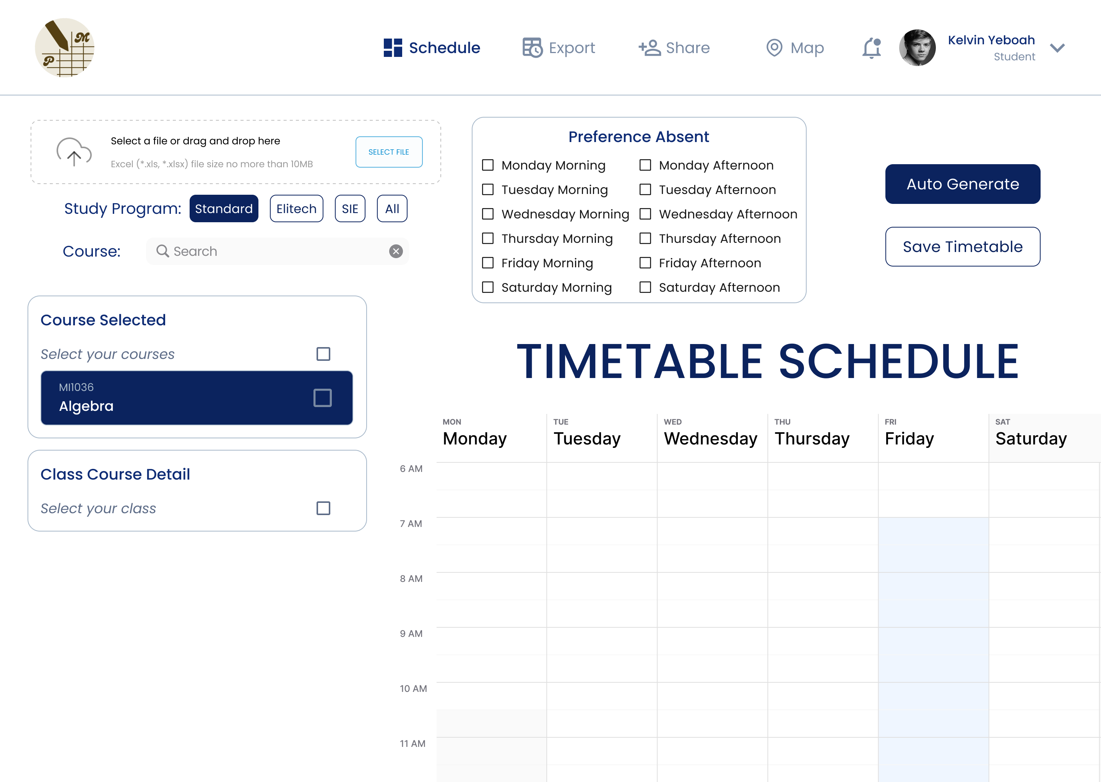
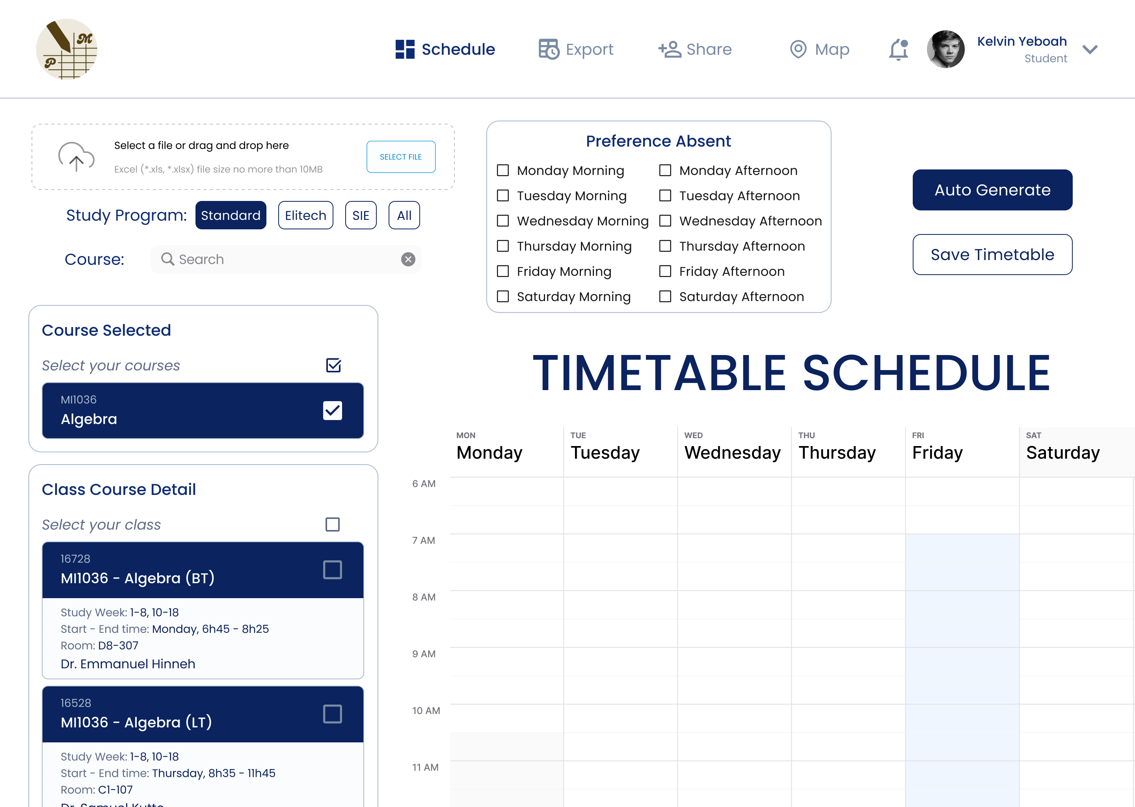
Complex Task Flow (2)
Automatically generate and
view a personalized
timetable
[Choose the course to show more information]
[The details of the classes of that course show up]

Slide 31
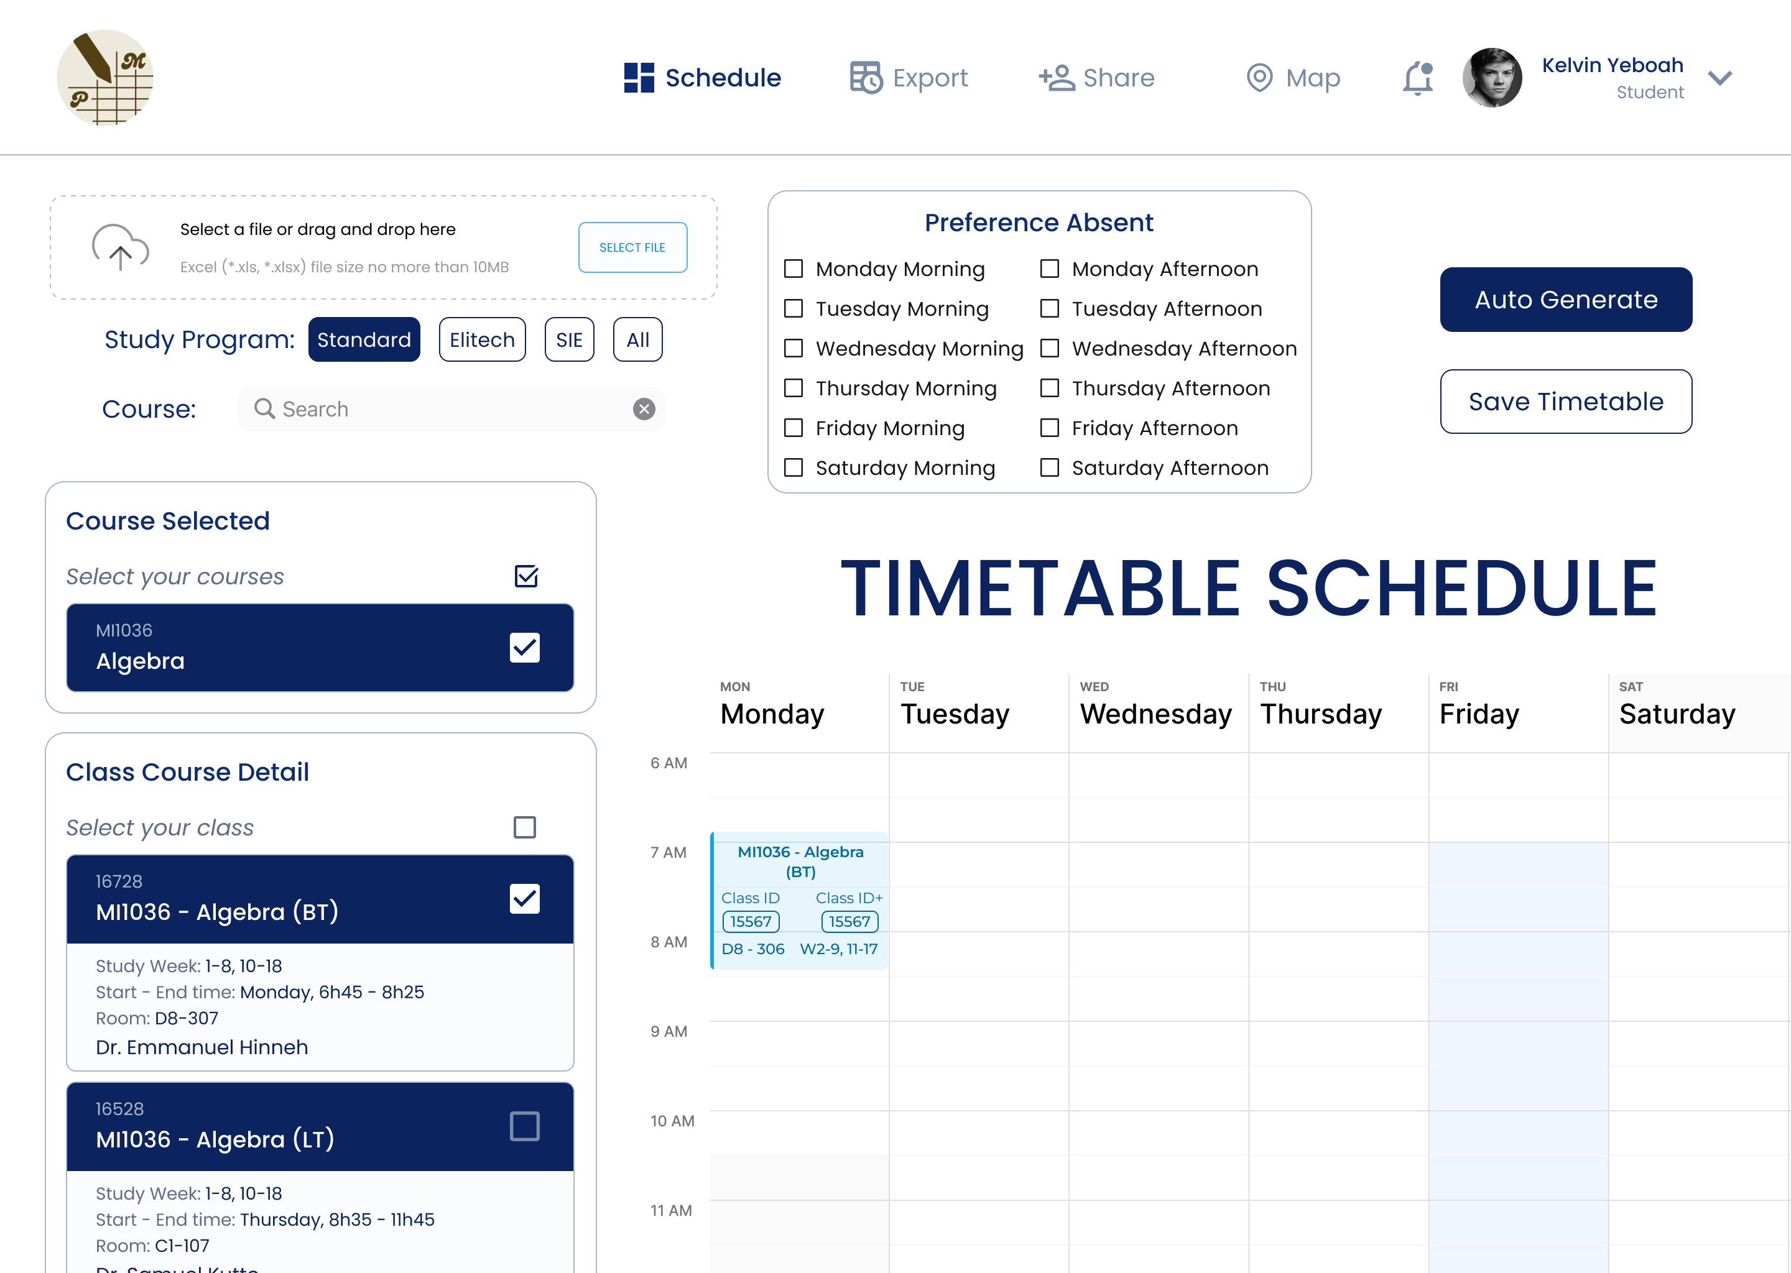
Complex Task Flow (3)
Automatically generate and
view a personalized
timetable
[Check the boxes from the “Preference Absent” checkboxes]
[Click on the “Auto Generate” button]
[The timetable automatically schedules, also the chosen class is checked]
P/S: Remember to click “Save Timetable” for further uses!

Slide 32
06
Prototype Implementation

Slide 33

Design And Prototyping Tools
Pros
Collaborative: Real-time feedback and team collaboration.
Interactive: Create clickable prototypes for testing.
User-Friendly: Easy to design and prototype without advanced skills.
Cloud-Based: Accessible from anywhere, enabling remote work.
Cons
Limited Interactivity: Can't fully simulate advanced user flows.
Performance: Large files may slow down.
Not Fully Realistic: Doesn’t replicate the full app experience.

Slide 34
Limitations And Trade-offs
No Specific User Profiles: Lacks personalized user data or profiles.
Incomplete Button Implementation: Some buttons are not fully functional, limiting interactions.
Limited Search and Import Features: Search and import course functions are not fully developed.
Incomplete Map Functionality: The map does not display all locations or features yet.
Limited Testing Scenarios: User flows and behaviors can't be fully tested as the prototype is not fully interactive.

Slide 35
Wizard-of-Oz
Course Search: Manually simulate the search results when users input a query, even if the search function isn't fully implemented.
Timetable Generation: Simulate automatic timetable creation by manually arranging courses, as the algorithm for auto-generating the timetable isn't active yet.
Map Functionality: The map is incomplete, simulate location-based actions, like showing the classroom locations, manually selecting from pre-defined spots on the map.
Save/Load Timetable: When users try to save or load timetables, simulate the action manually, even if backend storage isn’t implemented yet.

Slide 36
Hard-Coded Items
Predefined Timetable Layout: The layout for the timetable is fixed, with pre-set courses and schedule structure that users can view but not interact with dynamically.
Fixed Course List: The list of courses that users can choose from might be static, with no real-time updates or personalized course options.
Static Preferences: Preferences such as days or times for courses may be hard-coded into the interface, with limited options and no dynamic customization.
Map Display: The map is likely to show fixed locations, such as buildings, but does not dynamically update or adjust based on user input or the courses selected.

Slide 37

TIMETABLE PLANNER WEBSITE
Thanks
Listening!
AC4150E
-
152296
Me-fi Prototype
For
From:
Group 3

Slide 38
TIMETABLE PLANNER WEBSITE
Thanks
Listening!
APPENDIX
AC4150E
-
152296
For
Low-fi Prototype (and more!)
From:
Group 3

Slide 39



Me-fi Prototype
Have a try!

